Slide 1
Medical Advice Disclaimer The information, including but not limited to, text, graphics, images and other material contained in this presentation are for informational purposes only. NO material is intended to be a substitute for professional medical advice, diagnosis or treatment. Always seek the advice of your physician or other qualified health care provider with any questions you may have regarding a medical condition or treatment and before undertaking a new health care regimen. Never disregard professional medical advice or delay in seeking it because of something you have seen or heard during this presentation!

Slide 2
Covid 19 Vaccine – Behind the Curtain
Ephesians 6:11-13
¹¹ Put on the whole armour of God, that ye may be able to stand against the wiles of the devil.
¹² For we wrestle not against flesh and blood, but against principalities, against powers, against the rulers of the darkness of this world, against spiritual wickedness in high places.
¹³ Wherefore take unto you the whole armour of God, that ye may be able to withstand in the evil day, and having done all, to stand.
Mandy Bates & Lori McManus

Slide 3
To Trust or Not to Trust the Government
Operation Sunshine
In 1994, Bill Clinton formed an advisory committee to investigate “body snatching” by the Federal Government to study the effects of nuclear weapons tests. The Federal Government secretly took tissue samples from over 900 cadavers without knowledge or permission of the next of kin. In the final report issued by the advisory committee, details were provided about radiation experiments occurring from 1944 to 1974., where Plutonium and Uranium was injected in human subjects in homes for the mentally disabled as well as prison populations throughout the United States. Not only did they use injections, but the chemicals were also released into the atmosphere in a number of states across the United States.

Slide 4
To Trust or Not to Trust the Government
Willowbrook Experiments
In the early 1950’s, Saul Krugman, former flight surgeon for the US Army made a proposition to the Surgeon Generals Armed Forces Epidemiological Board. Krugman in search of a vaccine for hepatitis, infected mentally disabled children placed at Willowbrook in Staten Island, NY, with virus through a chocolate milk. Krugman coerced parents to participate by promising better living conditions in a new wing of Willowbrook which was already under scrutiny for its overcrowding, disease and neglect. In 1958, Krugman defended his experiments in a paper published in the New England Journal of Medicine, stating that these children would have been exposed anyway and the knowledge gained from the experiment would help other Willowbrook residents.

Slide 5
To Trust or Not to Trust the Government
Project MK-Ultra (mind control)
In the 1950’s the CIA began a number of experiments used to weaken minds for the purpose of control. 149 subprojects were carried out by 44 colleges/universities, 15 research foundations/pharmaceutical companies, 12 hospitals and 3 penal institutions. Doses, sometimes lethal, of LSD were given to unwitting citizens without medical supervision. Other experiments in the subprojects included shock therapies, sleep depravation, hypnosis, extrasensory perception and crop sabotage. Heroin addicts were enticed into taking LSD promised a reward of heroin. In1953, Dr Frank Olsen, a civilian employee at Fort Deitrick, leaped to his death from his New York City hotel room after unknowingly dosed with LSD. In 1977, a joint hearing of the Select Committee of Intelligence and Subcommittee on Health and Scientific Research produced a report uncovering this illegal experimentation* from what records remained after being intentionally destroyed.
*https://www.intelligence.senate.gov/sites/default/files/hearings/95mkultra.pdf

Slide 6
To Trust or Not to Trust the Government
Tuskeegee Syphilis Study
From 1932 to 1972, the US Public Health Service conducted studies to observe the natural history of untreated syphilis without the informed consent of African American test subjects intentionally infected. These men, were denied highly effective treatment discovered in 1940 and were actively discouraged from seeking medical advice or care from outside of the study. These men were given a diagnosis of “bad blood” and were told they were being treated for the diagnosis from the very researchers infecting them.
* https://www.ncbi.nlm.nih.gov/pmc/articles/PMC6258045/

Slide 7
To Trust or Not to Trust the Government
Operation Sea-Spray
In 1950, the US Navy participated in a biological warfare experiment to test vulnerability of a large city in the event of a biological terrorist attack. Serratia marcescens and Bacillus globigii bacteria were sprayed over the San Francisco Bay in California. The spread of this bacteria was tested at 43 sites and residents began to fall ill to the effects and Edward Nevin died as a result of the contagion*.
*https://www.smithsonianmag.com/smart-news/1950-us-released-bioweapon-san-francisco-180955819/

Slide 8
To Trust or Not to Trust the Government
The Malaria Project
In 1940’s, prisoners at the Stateville Penitentiary in Joiet, Illinois, were experimented on by the US Army and the State Department offering subjects reduced sentences for their participation. Subjects were infected with Malaria for the purpose of testing previously untested substances in the treatment of Malaria.*
In 1946, during the Nuremburg trials, the Nazi’s used this experiment as a point of defense for their experimentation of those captured during the war. Asked to differentiate the experiments, expert witness, Andrew Ivy, a physician from Chicago, provided minimal distinctions and admitted that the procedures, motives and premise of the studies were arguably similar.**
* https://pubmed.ncbi.nlm.nih.gov/24769747/
**https://en.wikipedia.org/wiki/Stateville_Penitentiary_Malaria_Study

Slide 9
To Trust or Not to Trust the Government
Measles Vaccine Experiment
In 1990 and 1991, the Centers for Disease control conducted experimental testing on over 1500 African American and Hispanic babies in lower income portions of Los Angeles. These babies were injected with measles vaccines, failing to disclose to the parents that the vaccine was experimental and did not have approval of the FDA. The CDC conducted this covert operation knowing that EZ-HT was previously tested in the 1980’s in in 3rd world countries such as Haiti, Mexico, Gambia, Togo and Senegal. A report published in the Lancet, indicates that this experimental testing resulting in an 80% higher death rate than those who received the standard measles vaccine. 1 in 80 children injected died.
In 1996, CDC Director, Dr. David Satcher, defended the CDC in the Los Angeles Times stating, “there was no ill intent” on the part of the agency in not telling parents that the vaccine had not been licensed for use in the United States, which is why it is termed “experimental” in this country. But things sometimes fall through the cracks”.
In the 1994 Report of the Institute of Medicine and Vaccine Safety Committee, the risk of death associated with the experimental vaccine was acknowledged.
*https://ahrp.org/1990-fda-issued-a-waiver-from-informed-consent-cdc-covertly-tested-experimental-vaccine-on-black-latino-babies/ ** https://www.thelancet.com/journals/lancet/article/PII0140-6736(91)91771-L/fulltext

Slide 10
Jackson Madison County Health Department

Slide 11
Defining Vaccine
In September 2021, the CDC changed the definition of vaccine from, “a product that stimulates a person’s immune system to produce IMMUNITY to a specific disease, protecting the person from that disease” to “a preparation that is used to stimulate the body’s immune response against diseases”.

Slide 12
What We Know
Prior to the Covid -19 Pandemic, Merriam-Webster defined vaccine as “a preparation of killed microorganisms, living attenuated organisms, or living fully virulent organisms that is administered to produce or artificially increase immunity to a particular disease”.
Pfizer and Moderna Covid -19 “vaccines” are the first mRNA shots released to the general public. These mRNA shots are created in a laboratory to teach cells how to make protein to trigger an immune response.

Slide 13
What We Know
Emergency Use Authorization
As of November 21, 2022, these “vaccines” are still not fully approved by the FDA. According to the FDA, under EUA, FDA may allow the use of unapproved medical products, or unapproved uses of medical products in an emergency to diagnose, treat, or prevent serious or life-threatening diseases or conditions when certain statutory criteria have been met including that there are no adequate, approved and available alternatives*
According to Pfizer, emergency uses of the vaccine have not been approved or licensed by the FDA but have been authorized by the FDA under EUA. The emergency uses are ONLY authorized for the duration of the declaration that circumstances exist in justifying the authorization of the emergency use under Section 564(b)(1) of the FD&C Act unless that declaration is terminated or authorization revoked sooner**
*https://www.fda.gov/vaccines-blood-biologics/vaccines/emergency-use-authorization-vaccines-explained
**https://www.pfizer.com/news/press-release/press-release-detail/pfizer-and-biontech-granted-us-emergency-use-authorization

Slide 14
What We Know
VAERS and V-Safe Reporting –
VAERS and V-Safe are passive surveillance systems reporting events voluntarily submitted by those who experience side effects and adverse reactions. The limitations of these systems include underreporting, reporting of unconfirmed diagnoses and lack of denominator data. As a result, relationships between “vaccines” and adverse events solely from VAERS reports is usually not possible *
*NIH https://www.ncbi.nlm.nih.gov/pmc/articles/PMC3834936/,

Slide 15
What We Know
Clinical Trials -
Published on September 22, 2022, found on the NIH website, a clinical trial for serious adverse events following mRNA Covid vaccination, it was determined the excess risk of serious adverse events found in the study points to the need for formal harm-benefit analysis, particularly those that are stratified according to rusk of serious Covid-19 outcomes.*
An investigative article written by Matthew E Oster, MD, MPH concluded that after review of mRNA Covid Vaccination in the US from December 2020 to August 2021 via the passive VAERS reporting, the risk of myocarditis increased across multiple age and sex strata**
*https://pubmed.ncbi.nlm.nih.gov/36055877/
**https://jamanetwork.com/journals/jama/fullarticle/2788346

Slide 16
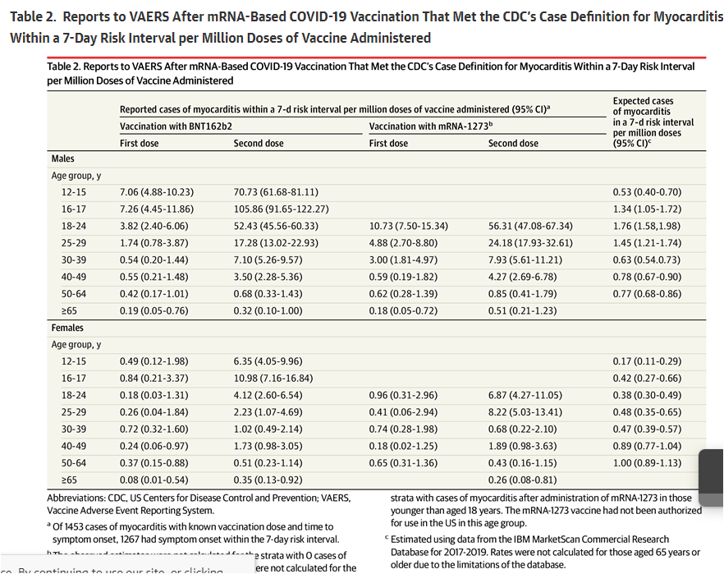
What We Know
As represented in the chart, the increase in expected vs. actual cases of myocarditis after the second dose, particularly in the male population, is an alarming 98% within a 7-day interval
The increase in expected vs. actual cases of myocarditis after the second dose, in females ages 18-29 was an alarming 94%

Slide 17
What We Know
On Wednesday, December 7, 2022, Senator Ron Johnson lead a roundtable discussion to shed light on the current state of knowledge surrounding the Covid Vaccine. In this video, Lt. Col. Theresa Long, MD, MPH, FS discusses her clinical findings in military personnel reported to the DOD medical surveillance system who’ve received Covid vaccination. (30.00-32.22)
https://rumble.com/v1znkoq-dr.-teresa-long..-clinical-finding-in-military-personnel.html
Full video of this roundtable discussion can be found here: https://rumble.com/v1zf6ma-covid-19-vaccines-what-they-are-how-they-work-and-possible-causes-of-injuri.html

Slide 18
What We Know
In this same roundtable discussion, Janci Lindsay, PhD, Director of Toxicology and Molecular Biology for Toxicology Support Services, LLC discusses safety concerns including sterilization and changes to DNA after receiving MrNA based vaccine from both Pfizer and Moderna (1:07.47 – 1:11:45)
David Wiseman, PhD, MRPharmS, former Johnson & Johnson researcher discusses FDA approval was remiss in reviewing this gene therapy during the approval process which is a separate arm of FDA that studies gene therapy which the MrNA vaccine is (1:11:58-1:13.51)
Dr Ryan Cole, MD, of Idaho, specializing in Anatomic Pathology, Clinical Pathology, Dermatopathology discusses the CDC’s changing definition of vaccine when Covid vaccine was introduced as previously mentioned in our presentation.
In January, 2023, in order to silence Dr. Cole, the Washington Medical Board charged Dr. Cole with violations of standards related to Covid -19 and patient care. *
Full video of this roundtable discussion can be found here: https://rumble.com/v1zf6ma-covid-19-vaccines-what-they-are-how-they-work-and-possible-causes-of-injuri.html
*https://wmc.wa.gov/news/statement-charges-served-physician-license-ryan-cole

Slide 19
What We Know
As part of the licensing approval process for the Pfizer Vaccine, (Comirnaty) FDA required Pfizer to complete a study* on subclinical myocarditis , after receipt of it’s Covid vaccine. In the letter dated August 23, 2021, the completion date of this study was June 20, 2022. After this deadline passed, the FDA changed the date of this study to June 30, 2023. Pfizer submitted a timetable to the FDA stating that the company would submit final protocol by November 30, 2021, and complete the study by June 30, 2022, however the results of that study are currently pending
Shockingly, this letter describes postmarketing study requirements required for submission to the FDA to evaluate the safety and effectiveness in children.
Study 1 – Deferred pediatric Study C4591001 to evaluate safety and effectiveness of Comirnaty in children 12 years through 15 years of age. Study completion date 5/31/23
Study 2 - Deferred pediatric Study C4591007 to evaluate safety and effectiveness of Comirnaty in infants and children 6 mo <12 years of age. Study completion date 11/30/2023
Study 3 - Deferred pediatric Study C4591023 to evaluate safety and effectiveness of Comirnaty in infants <6 months of age. Study completion date 07/31/2024
What does this tell us? Children currently receiving Pfizer vaccinations are the test subjects for the expiramental vaccines. Studies on safety and effectiveness are in process and not due for review and submission to the FDA effectively until mid 2023. A full year and three months after licensing was issued to Pfizer to manufacture and administer vaccines to children!!
*https://www.documentcloud.org/documents/23569895-fda-approval-letter-to-pfizerexamine post-vaccination adverse events.

Slide 20
What We Know
On September 8, 2022, Centers for Disease Control and Prevention (HHS) posted a federal grant opportunity, RFA-IP-23-006, to develop a public health tool to predict the virality of vaccine misinformation narratives. Applications for this grant were due January 6th, 2023.
Estimated funding for this grant - $1 million
Eligible Applicants –
State governments Public and State controlled institutions of higher education Native American tribal organizations (other than Federally recognized tribal governments) Nonprofits having a 501(c)(3) status with the IRS, other than institutions of higher education Special district governments City or township governments Native American tribal governments (Federally recognized) Nonprofits that do not have a 501(c)(3) status with the IRS, other than institutions of higher education Public housing authorities/Indian housing authorities Independent school districts County governments Others (see text field entitled "Additional Information on Eligibility" for clarification)
*https://www.grants.gov/view-opportunity.html?oppId=343402

Slide 21
What We Know
According to its own website, CDC and its partners are actively monitoring reports of myocarditis and pericarditis after Covid vaccination.* However, the last updated report of any follow-up study was September 23, 2022. These results were published by The Lancet on September 21, 2022. The study provides data on outcomes in individuals with myocarditis after mRNA Covid vaccination and quality of life at least 90 days since onset of myocarditis after mRNA vaccination between the dates of August 24, 2021 and January 12, 2022**.
*https://www.cdc.gov/coronavirus/2019-ncov/vaccines/safety/myocarditis.html
**https://www.thelancet.com/journals/lanchi/article/PIIS2352-4642(22)00244-9/fulltext

Slide 22
What We Know
The Lancet Study Data * –
Surveys were conducted in US individuals aged 12-29 with myocarditis after mRNA whom a report was filed to the passive reporting VAERS system between January 12 and November 5 2021.
Data was collected for 519 of the 836 eligible patients via patient survey and health care provider survey. Median patient age 17 years with 88% being male and 12% female. 393 patients received a health care provider assessment for myocarditis which is an astounding 75.7%. 104 patients (26%) were prescribed daily medication related to myocarditis
*https://www.thelancet.com/action/showPdf?pii=S2352-4642%2822%2900244-9

Slide 23
What We Know
The Lancet Study Data (cont) * –
249 individuals completed the quality of life portion on the patient survey which yielded the following results:
4 (2%) reported problems with self-care
13 (5%) reported mobility issues
49 (205) reported problems performing usual activities
74 (30%) reported pain
114 (46%) reported signs of depression
Final Interpretation – These findings might not be generalizable given the small sample size. Further follow-up is needed for the subset of patients with atypical test results.
What this tells me? Ongoing and ample studies have not been completed to support safety, efficacy and continued recommendation of mRNA vaccines in children. This also tells me that information available on VAERS, the passive reporting system being used to collect the data, is clearly not provided sufficient sample sizes to complete the studies used in the determination of continued recommendations.
*https://www.thelancet.com/action/showPdf?pii=S2352-4642%2822%2900244-9

Slide 24
What We Know
The Lancet Study Data (cont) * –
249 individuals completed the quality of life portion on the patient survey which yielded the following results:
4 (2%) reported problems with self-care
13 (5%) reported mobility issues
49 (205) reported problems performing usual activities
74 (30%) reported pain
114 (46%) reported signs of depression
Final Interpretation – These findings might not be generalizable given the small sample size. Further follow-up is needed for the subset of patients with atypical test results.
What this tells me? Ongoing and ample studies have not been completed to support safety, efficacy and continued recommendation of mRNA vaccines in children. This also tells me that information available on VAERS, the passive reporting system being used to collect the data, is clearly not provided sufficient sample sizes to complete the studies used in the determination of continued recommendations.
*https://www.thelancet.com/action/showPdf?pii=S2352-4642%2822%2900244-9

Slide 25
What We Know
January 13, 2023
The CDC and FDA Identify preliminary Covid 19 Vaccine Safety Signal for persons aged 65 and older. According to the site, “Following the availability and use of the updated (bivalent) COVID-19 vaccines, CDC’s Vaccine Safety Datalink (VSD), a near real-time surveillance system, met the statistical criteria to prompt additional investigation into whether there was a safety concern for ischemic stroke in people ages 65 and older who received the Pfizer-BioNTech COVID-19 Vaccine, Bivalent. Rapid-response investigation of the signal in the VSD raised a question of whether people 65 and older who have received the Pfizer-BioNTech COVID-19 Vaccine, Bivalent were more likely to have an ischemic stroke in the 21 days following vaccination compared with days 22-42 following vaccination.”
*https://www.cdc.gov/coronavirus/2019-ncov/vaccines/safety/bivalent-boosters.html

Slide 26
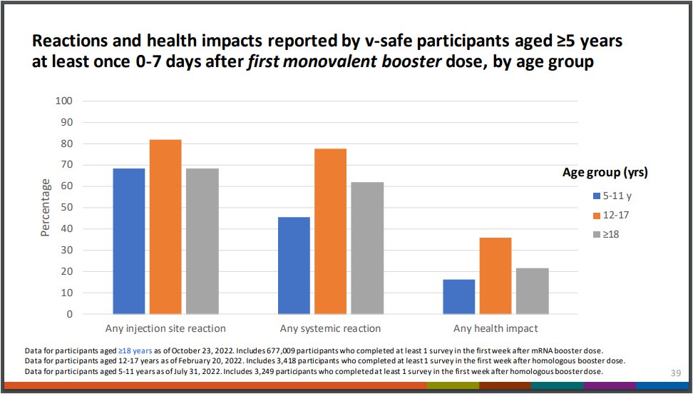
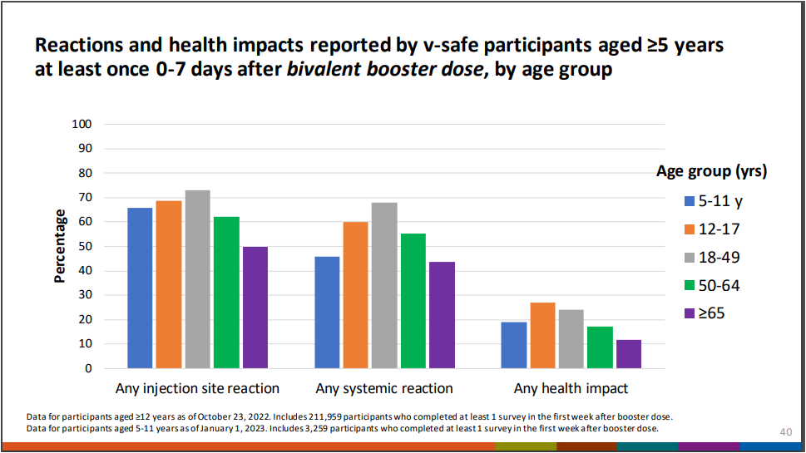
What We Know
January 26, 2023
The Vaccines and Related Biological Products Advisory Committee presented the following results.
https://www.fda.gov/media/164811/download
https://www.fda.gov/media/164811/download 12-17 2,666 Systemic Reaction 12-17 1298 Any health impact 5-11 1955 Systemic Reaction 912 Health Impact

Slide 27
What We Know
As mentioned in series one of our presentation, Lori reached out to one of the largest funeral homes in Jackson who wished to remain anonymous for purposes of this presentation.
In the course of embalming, since the inception of the Covid -19 Vaccine, they confirmed that they are in fact seeing the clots as shown in Stew Peter’s Died Suddenly. They also reported that they have never seen this type of clot in their work since Covid -19.
You can watch the full movie Died Suddenly here:
https://www.stewpeters.com/video/2022/11/live-world-premiere-died-suddenly/

Slide 28
What We Know
Tucker Carlson Today – Sudden Death Epidemic
https://beforeitsnews.com/opinion-conservative/2023/02/tucker-carlson-today-sudden-death-epidemic-a-must-video-3655806.html?fbclid=IwAR3SPgY9D3gjR0Tuxh5Nb8BNSaoW_wu-dBVlJ-KJWLJ5LBGDaWHWoXM55wM

Slide 29
What Can We Do? 1. STAY VOCAL 2. Petition 3. Franks v. Sykes 600 SW3d 908 (Tenn. 2020) Tennessee Supreme Court Ruling which permits a cause of action under the Tennessee Consumer Protections Act of 1077 for allegation of injury caused by a health care provider’s business practices. In this ruling, the Supreme Court reversed a lower courts decision indicating that there is a distinction between a health care providers ACTIONS and their BUSINESS PRACTICES. The Supreme Court opined that healthcare providers and hospitals must still comply with TCPA which protects consumers from deceptive advertising, while the actions of healthcare providers and hospitals fall under the Health Care Liability act https://www.tncourts.gov/sites/default/files/franks.roy_.opn_.pdf https://barrettlawofficetn.com/blog/tennessee-consumers-victory/

